Slide 1

Toolkit Doc10 Base Skirts
April 30, 2010

Slide 2
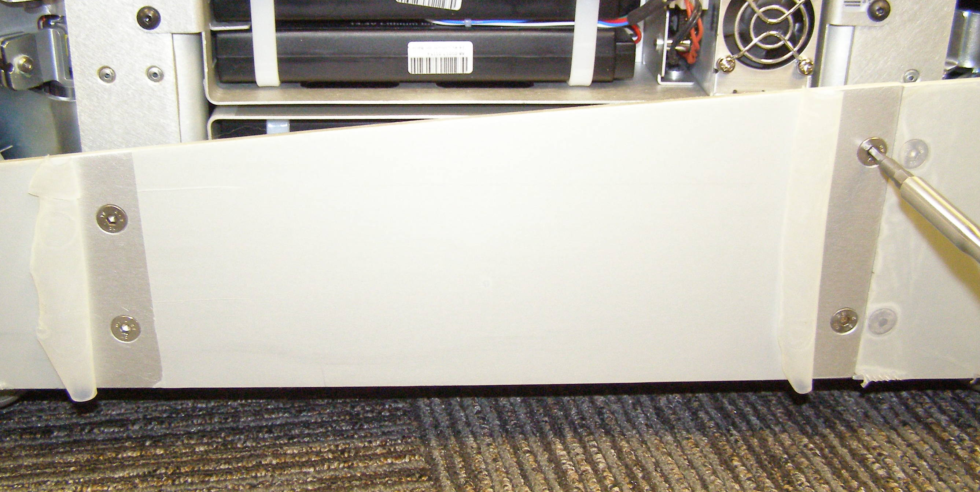
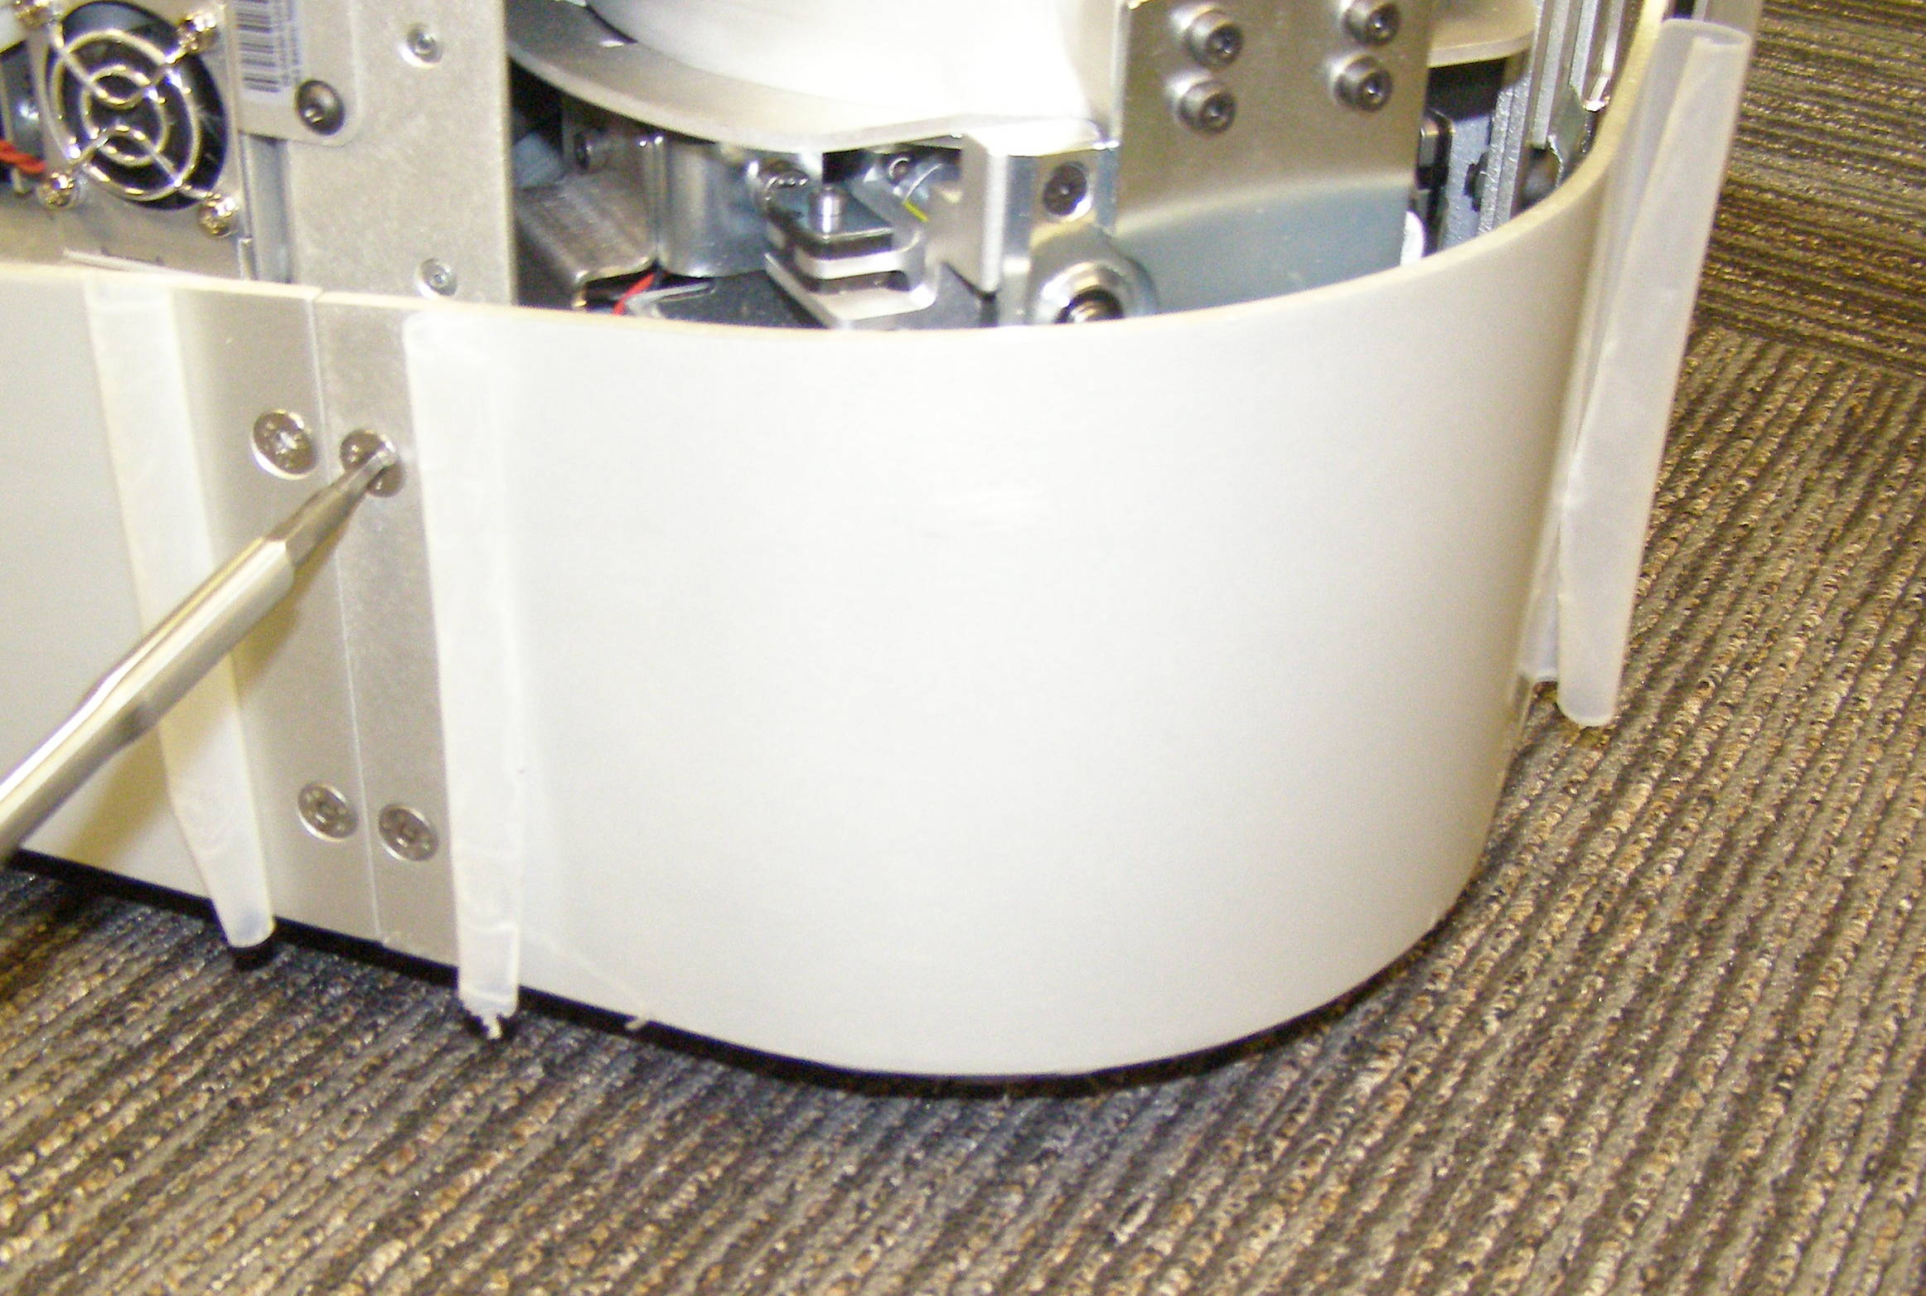
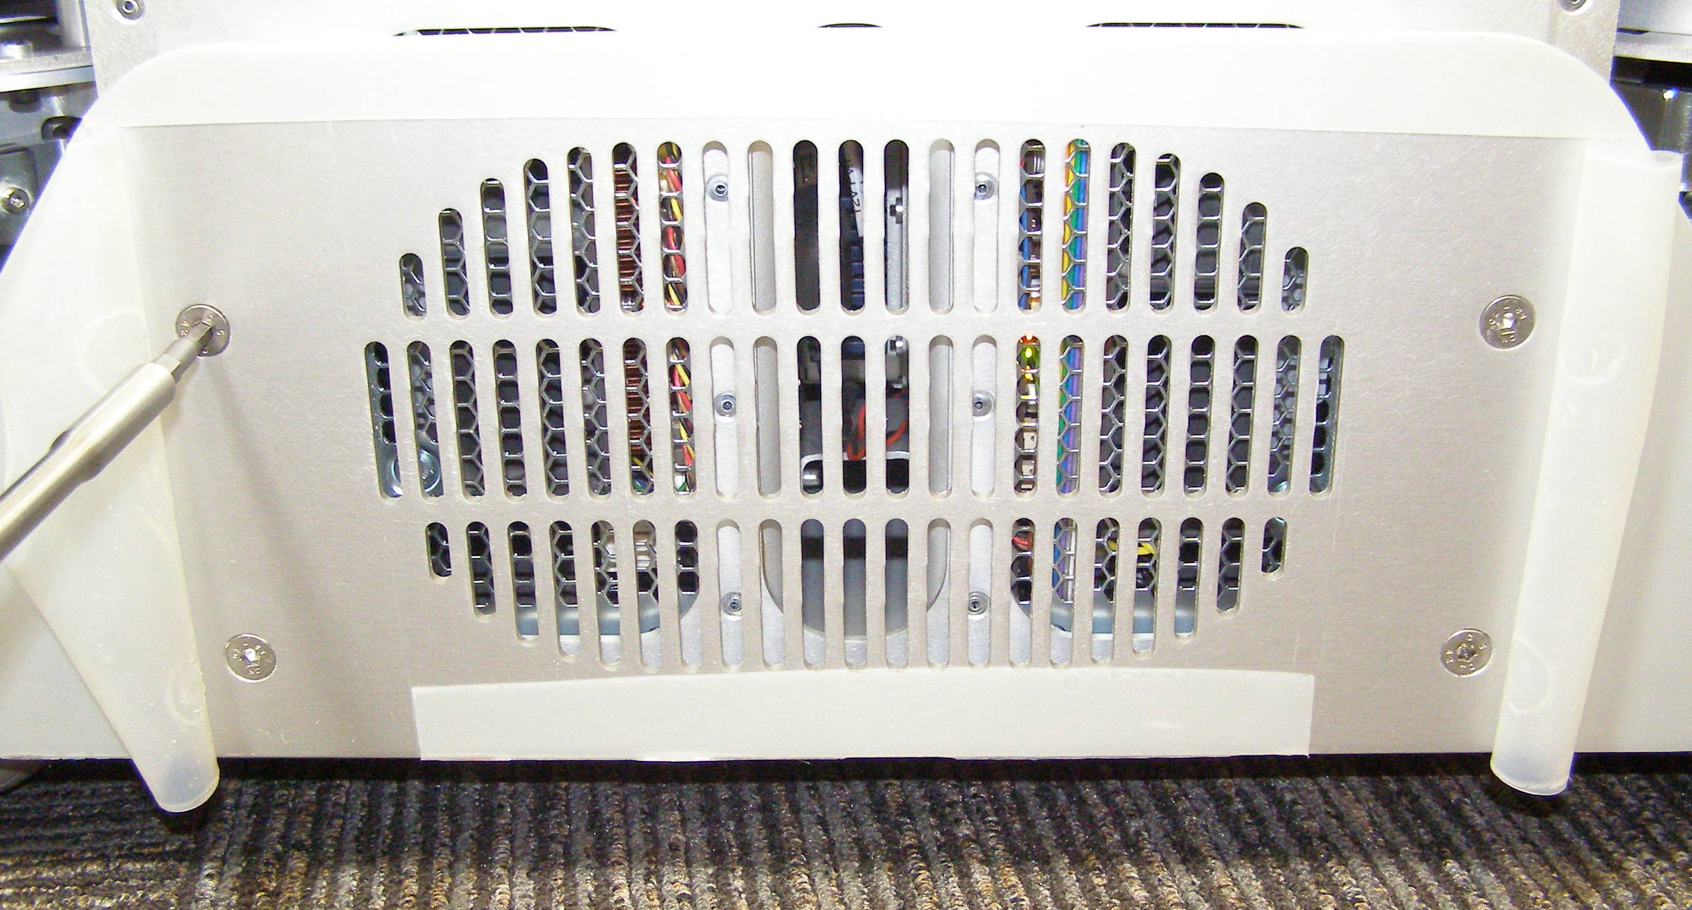
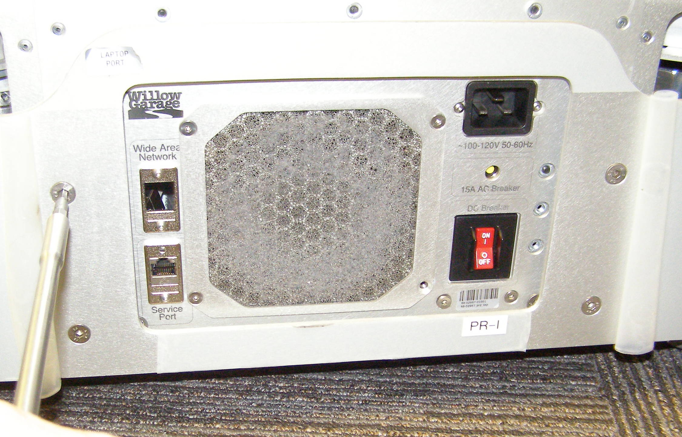
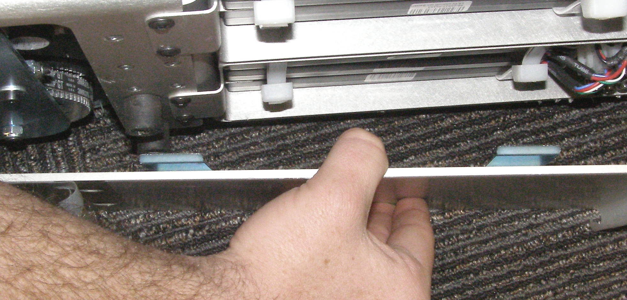
Base Skirt Front + Rear R/R
Base Skirt Front, Removal – 1422
  Remove Front Bottom Panel
  Using the 4mm bit with the T-handle driver, remove 12 screws starting at the back working your way to the front. 3063-08 (Fig 1,2)
  To remove first pull the Skirt sides appart slightly so the tabs clear the rubber standoffs, and then move the Skirt forward. (Fig 3)
Base Skirt Rear, Removal – 1539
  Using the 4mm bit with the T-handle driver, remove 8 screws starting at the sides working your way to the rear. 3063-08 (Fig 4,5)
Base Skirt Front or Rear, Install
  Reverse the removal procedure.
  Using Loctite 248, install the screws and torque to 6.34Nm using the Large torque driver.
Fig 1
Fig 4
Fig 2
Fig 5
Rubber
Fig 3

